Slide 1
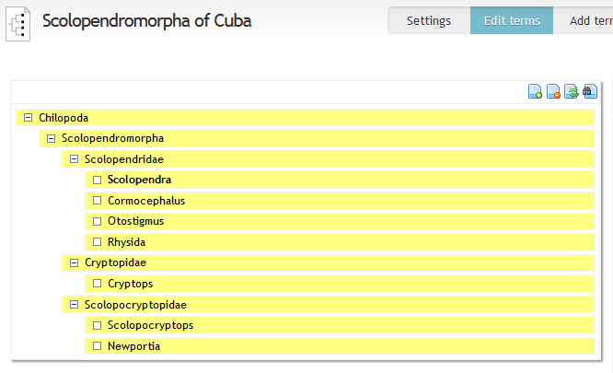
This non alphabetical arrangement is desired

Slide 2
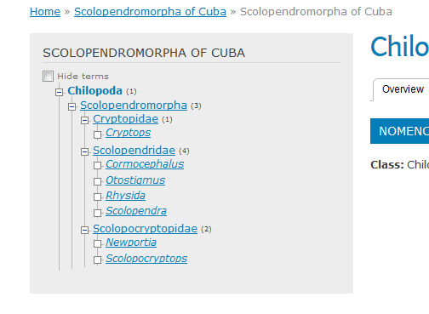
This alphabetical arrangement is displayed

Slide 3
How to make the tree on the webpage to display in a non alphabetical arrangement, just like the tree on the taxonomic editor?

